Slide 1





L-UNiX
HACKTOBERFEST 1.0

Slide 2







Deployment of an innovative culinary recipe website that enables customers to find for recipes by keywords and features a user-friendly search engine.
Given an ingredient-based search function that displays
recipes that can be created with the materials available
Items.
arranging them according to the acquiring
how many items are missing for the user desired meal in a most efficient way.

Slide 3




t
Solution
The way we would put the solution into practise would be by developing a website with easily accessible recipes.
We are the
“
“

Slide 4


Key Features and Functionality
An interactive user-friendly interface Download weekly recipes on Whatsapp ,Receive randomized recipes.
We connect the all people in need and who are able to provide .

Slide 5


‘.g,
Social impact
Often you have to cook, and other times you just want to cook. Our website makes it easy for you to learn how to prepare anything you desire.
This website will benefit our customers as well as bring together various individuals who have a passion for cooking.
The website will be easy to use for elderly people who are not used to technology

Slide 6


Revenue Model
The revenue we generate will be derived from marketing materials and a subscription model for clients, which indicates we receive additional benefits.

Slide 7



Technologies Used
GitHub
Crowd sourcing
Blockchain based recipe database
Push notifications for user defined time through WhatsApp platform
Supa base , MySQL , Python3 for DBMS
HTML,CSS , .js
Spline UI/UX

Slide 8



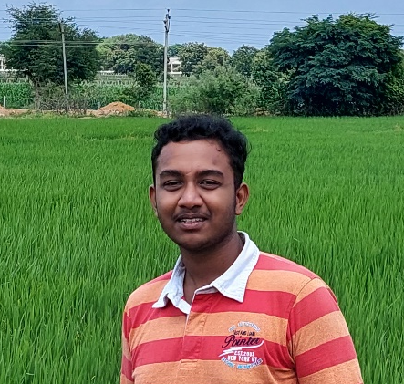
The Team
Himanshu
Kumar sah
Avipsa
B.Mithilesh
Member 1
Member 2
Member 3

Slide 9


Thank You
HACKTOBER FEST

